Slide 1
Equipment Qualification
flow Steps

Slide 2
Process Flow
User Requirement Specifications (URS).
Design Qualification.
Factory Acceptance Test (FAT).
Site Acceptance Test (SAT).
Installation Qualification (IQ).
Operational Qualification (OQ).
Process Qualification (PQ).

Slide 3
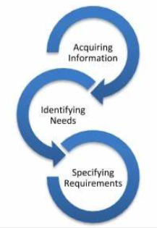
User requirement specifications (URS)
Equipment Identification and Description.
Equipment Purpose and Intended Use.
Equipment Capacity and Output.
Regulatory Compliance.
Safety Requirements.
Equipment Materials and Construction.

Slide 4
User requirement specifications (URS)
Process Control and Automation.
Cleaning and Maintenance.
Training and User Documentation.
Equipment Validation.
Equipment Integration.
Delivery, Installation, and Support.

Slide 5
Design Qualification (DQ)
The proposed design of the facilities, equipment, or systems is suitable for the intended purpose.
It is a verification process of design to meet specific requirements related to quality of pharmaceuticals and manufacturing practices.
The Design Review/Design Qualification process provides assurance that the design deliverables are consistent with the User Requirements Specification and the mitigation control strategies determined during the System Risk Assessment.
Design Qualification is focused on Critical aspects and Critical Design Elements and involves the Quality unit as an approver.

Slide 6
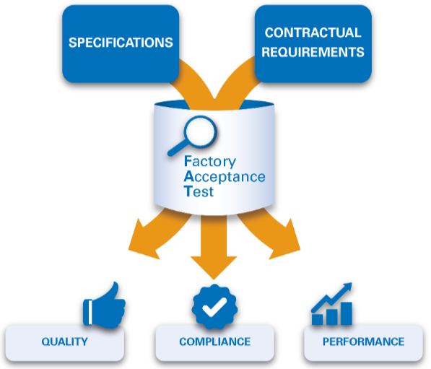
Factory Acceptance Test (FAT)
The FAT aims to verify the performance, functionality, and compliance of the equipment with both international standards and the customer's specific requirements.
Documentation Review (Electrical, P&ID, Manuals, CAL certificates).
Equipment Inspection (To verify Equipment to meet FAT)
Functional Testing.
Performance Testing.
Safety Testing.
Software Validation.
Environmental Conditions.
Acceptance Documentation.

Slide 7
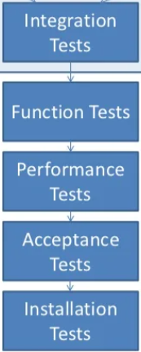
Site Acceptance Test (SAT)
The process of verifying and validating the functionality and performance of the equipment at the actual site where it will be used.
Preparing the Test Plan.
Test Setup and Installation.
Document Review.
Operational Qualification (OQ).
Performance Qualification (PQ).
Safety and Compliance Testing.
System Integration.
Training and User Acceptance.

Slide 8
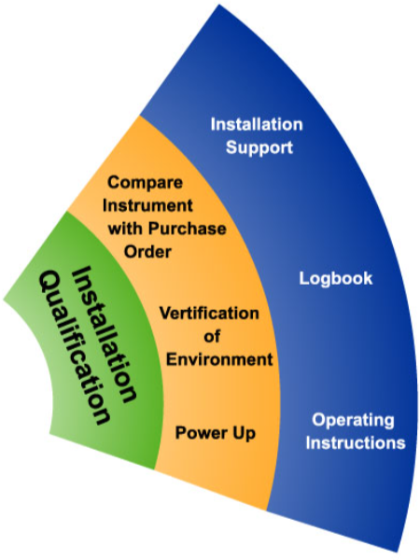
Installation Qualification (IQ)
IQ Protocol preparation and Execution.
Physical Inspection.
Documentation Review.
Calibration and Verification.
Electrical and Utility Connections.
Safety Checks.

Slide 9
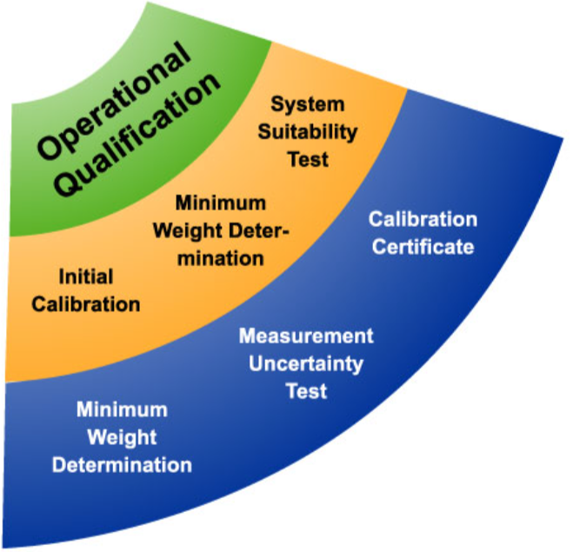
Operational Qualification (OQ)
Develop an OQ protocol and Execute:
Define acceptance criteria.
Perform operational tests.
Verify equipment controls and safety features.
Document and analyze results.

Slide 10
Process Qualification (PQ)
Consistency and reliability in producing the desired output.
Multiple test runs or process simulations, adhering to predefined protocols and acceptance criteria.
The various parameters monitored during the PQ may include yield, product quality, accuracy, precision, reproducibility, and other performance indicators.

Slide 11
Quality Compliance
ASME BPE (American Society of Mechanical Engineers Bioprocessing Equipment)- It covers materials, design, fabrication, inspections, testing and certification.
NIST (National Institute of Standards and Technology)- is for Calibration standards.
21CFR part 11- Regulations on Electronic records and Signatures.

Slide 12


